Slide 1

Positioning

Slide 2
Positioning Elements with CSS
With the exception of floating elements right or left, we have thus far allowed our page elements to appear one after another down the screen. Using CSS, we can depart from this normal flow in order to:
force an element to stay fixed in the same place in the browser window, even while the user continues to scroll further down the page.
move elements up, down, right, or left relative to their normal position on the page.
remove elements from their normal position and place them in a precise location within the page content.
allow elements to overlap and to specify which appears in front and which appears in back.

Slide 3
Positioning Properties and Values
The CSS position property has four different values we will use:
static - places the element in its usual location in the normal document flow. This is the default value.
fixed - removes the element from the normal document flow and fixes it to a specific location in the browser window. Even when the page is scrolled, its location will remain the same.
relative - keeps the element in the normal document flow but allows us to move it around relative to its normal location.
absolute - removes the element from the normal document flow and allows us to place it in a specific location. It will scroll along with the surrounding page content.
The position property is used in conjunction with the top, bottom, right, and left CSS properties. Let's see some examples how these work together.

Slide 4
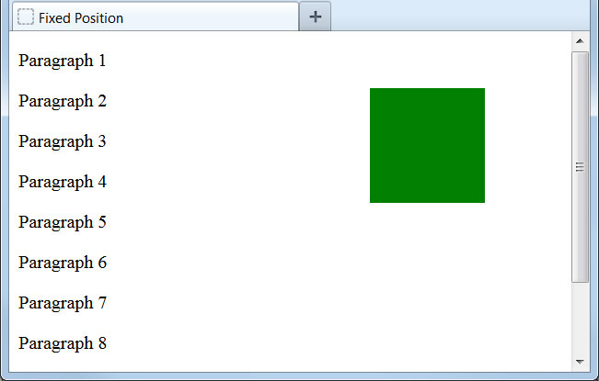
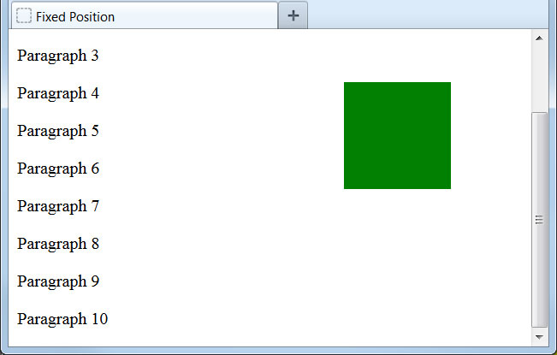
Fixed Position
Let's use the position property to fix an element to a specific location in the browser window:
.box1 {
height: 100px;
width: 100px;
background-color: green;
position: fixed;
top: 50px;
right: 75px;
}
...
<div class="box1"></div>
<p>Paragraph 1</p>
<p>Paragraph 2</p>
...
We have pinned this element to a fixed location, 50px from the top edge and 75px from the right edge of the browser window. Even as we scroll the page content, the element remains in the same place.

Slide 5
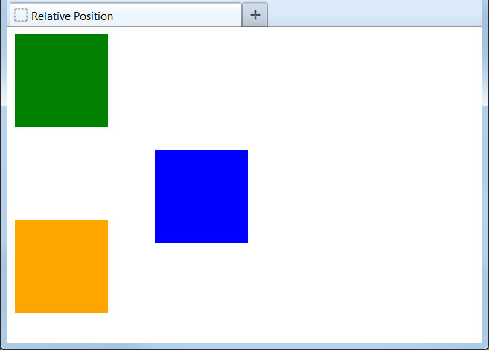
Relative Position
Now let's move an element relative to its normal position:
.box1 {
height: 100px;
width: 100px;
background-color: green;
}
.box2 {
height: 100px;
width: 100px;
background-color: blue;
position: relative;
top: 25px;
left: 150px;
}
.box3 {
height: 100px;
width: 100px;
background-color: orange;
}
...
<div class="box1"></div>
<div class="box2"></div>
<div class="box3"></div>
Using relative position, we can nudge elements or even move them to the other side of the page.
Remember that relative positioning keeps the element in the normal document flow. No matter where we move the element, its original location will be reserved on the screen.

Slide 6
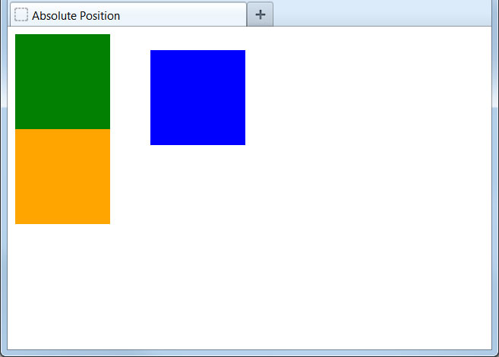
Absolute Position
Here we will change the element to have an absolute position:
.box1 {
height: 100px;
width: 100px;
background-color: green;
}
.box2 {
height: 100px;
width: 100px;
background-color: blue;
position: absolute;
top: 25px;
left: 150px;
}
.box3 {
height: 100px;
width: 100px;
background-color: orange;
}
...
<div class="box1"></div>
<div class="box2"></div>
<div class="box3"></div>
Absolute positioning places the element not relative to its normal position but from the top left corner of the page.
Like fixed positioning, absolute positioning removes the element from the normal document flow. Other elements will appear on the page the same as if this element did not exist.

Slide 7
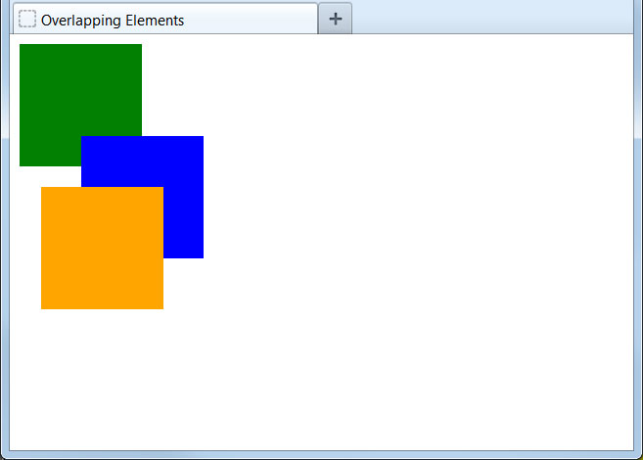
Overlapping Elements
Positioning elements can cause them to overlap on the page:
.box1 {
height: 100px;
width: 100px;
background-color: green;
}
.box2 {
height: 100px;
width: 100px;
background-color: blue;
position: relative;
top: -25px;
left: 50px;
}
.box3 {
height: 100px;
width: 100px;
background-color: orange;
position: absolute;
top: 125px;
left: 25px;
}
...
By default, the element last added to the page will appear on top of all others and the first element will appear below all others.
Note that we can set position values to be negative numbers. This can even be used to pull elements partially off the visible page.

Slide 8
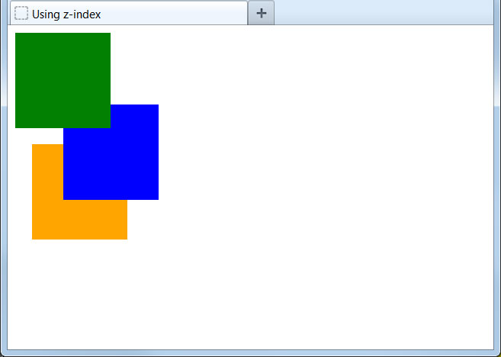
Controlling the Overlap
We can override the default precedence by setting the z-index property:
.box1 {
height: 100px;
width: 100px;
background-color: green;
position: relative;
z-index: 3;
}
.box2 {
...
position: relative;
top: -25px;
left: 50px;
z-index: 2;
}
.box3 {
...
position: absolute;
top: 125px;
left: 25px;
z-index: 1;
}
...
Higher z-index values will always appear on top of lower ones, so we can precisely control how elements stack on the page.
For the z-index to work, an element must be positioned as relative, absolute, or static.

